Slide 1
Announcements
Homework 6 is out
Due on May 27th (same date as the original final exam)
No arXiv link!
Course evaluations
On top of your Canvas
Notes:
Dr. Kevin Guidry

Slide 2
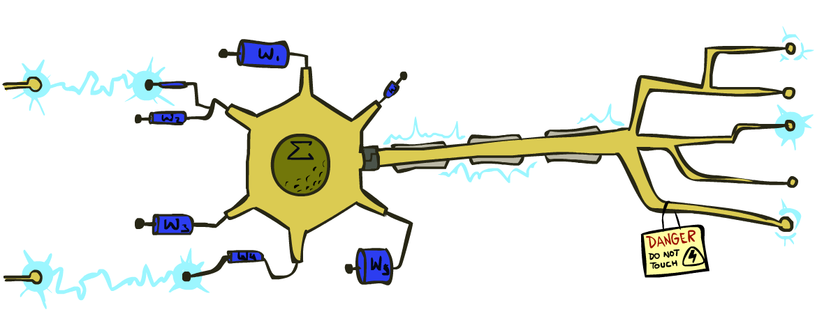
Intro to Dear AI
Perceptrons and Logistic Regression
Instructor: Rahmat Beheshti
With slides from Dan Klein and Pieter Abbeel at UC Berkeley (ai.berkeley.edu)

Slide 3
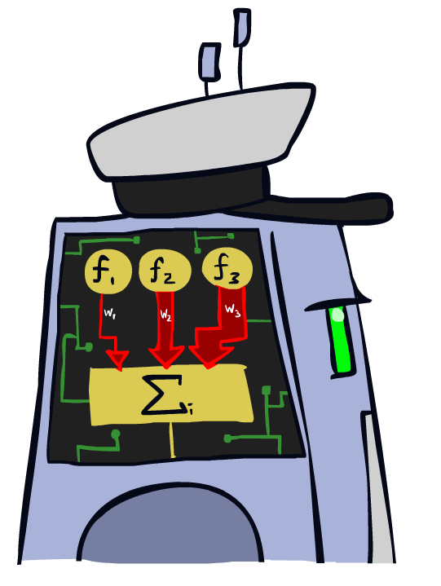
Linear Classifiers

Slide 4
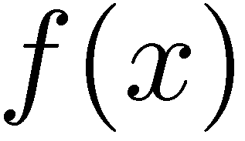



Feature Vectors
Hello,
Do you want free printr cartriges? Why pay more when you can get them ABSOLUTELY FREE! Just
# free : 2
YOUR_NAME : 0
MISSPELLED : 2
FROM_FRIEND : 0
...
SPAM
or
+
PIXEL-7,12 : 1
PIXEL-7,13 : 0
...
NUM_LOOPS : 1
...
“2”

Slide 5
Some (Simplified) Biology
Very loose inspiration: human neurons

Slide 6
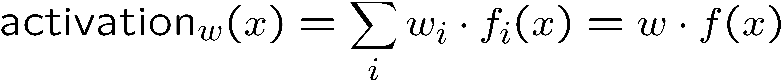
Linear Classifiers
Inputs are feature values
Each feature has a weight
Sum is the activation
If the activation is:
Positive, output +1
Negative, output -1
w₁
f₁
Σ
w₂
>0?
f₂
w₃
f₃

Slide 7


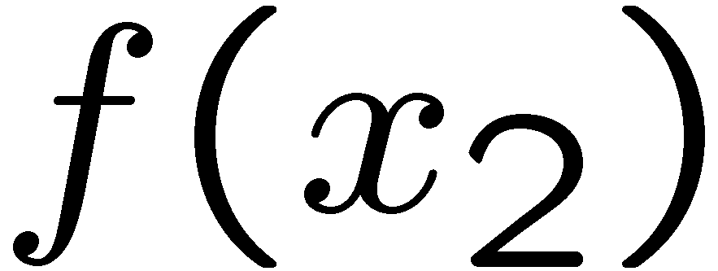
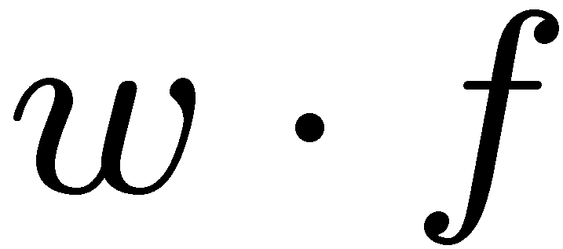
Weights
Binary case: compare features to a weight vector
Learning: figure out the weight vector from examples
# free : 4
YOUR_NAME :-1
MISSPELLED : 1
FROM_FRIEND :-3
...
# free : 2
YOUR_NAME : 0
MISSPELLED : 2
FROM_FRIEND : 0
...
# free : 0
YOUR_NAME : 1
MISSPELLED : 1
FROM_FRIEND : 1
...
Dot product positive means the positive class

Slide 8
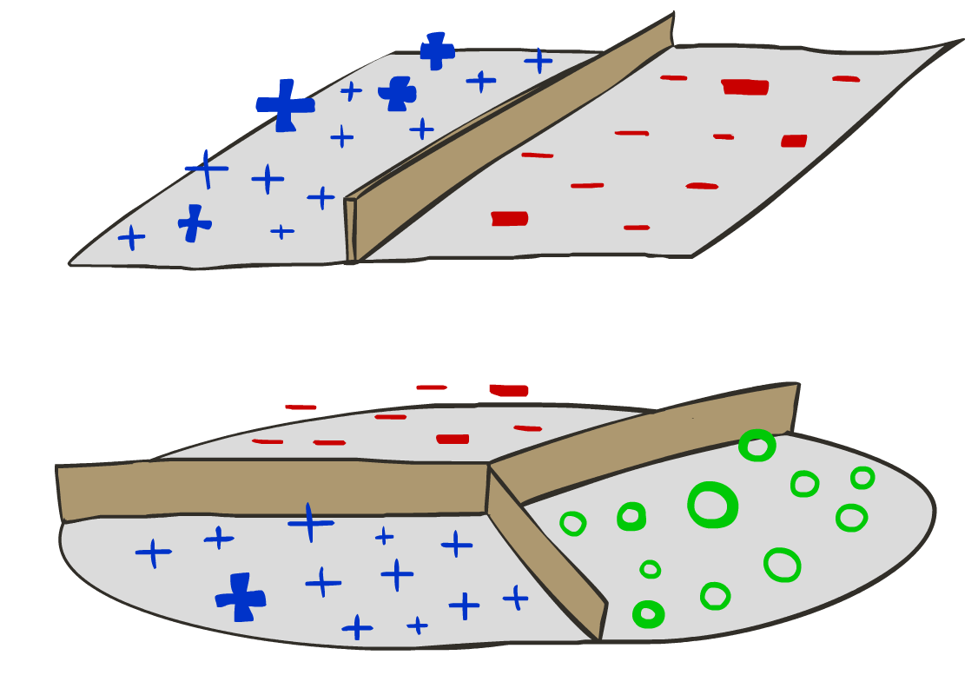
Decision Rules

Slide 9

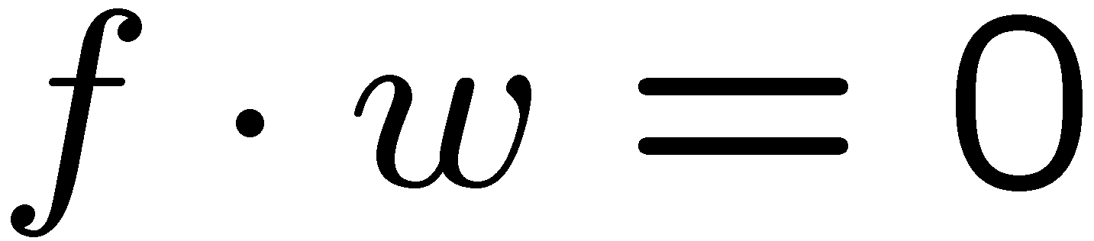
Binary Decision Rule
In the space of feature vectors
Examples are points
Any weight vector is a hyperplane
One side corresponds to Y=+1
Other corresponds to Y=-1
money
2
+1 = SPAM
1
BIAS : -3
free : 4
money : 2
...
0
-1 = HAM
0
1
free

Slide 10

Weight Updates

Slide 11
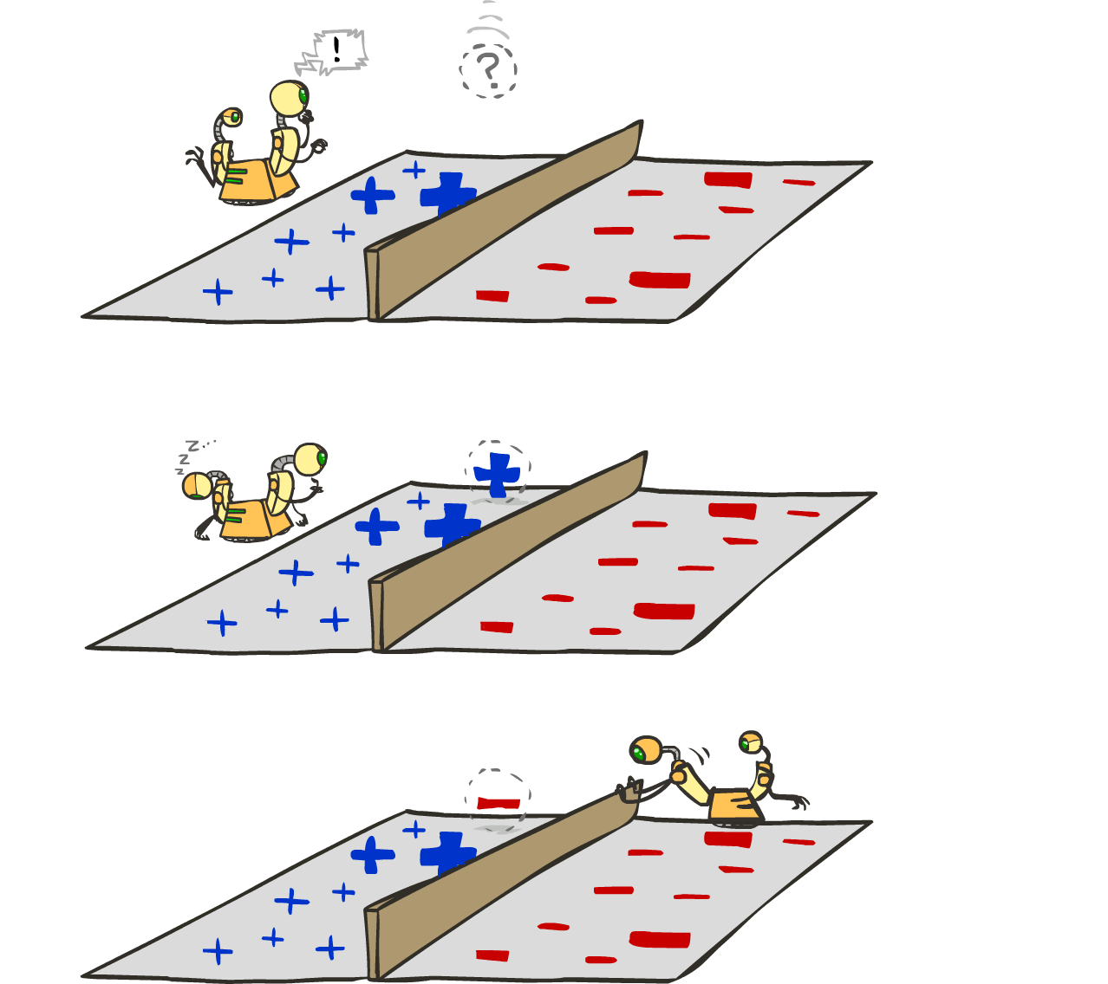
Learning: Binary Perceptron
Start with weights = 0
For each training instance:
Classify with current weights
If correct (i.e., y=y*), no change!
If wrong: adjust the weight vector
Notes:
http://isl.ira.uka.de/neuralNetCourse/2004/VL_11_5/Perceptron.html

Slide 12

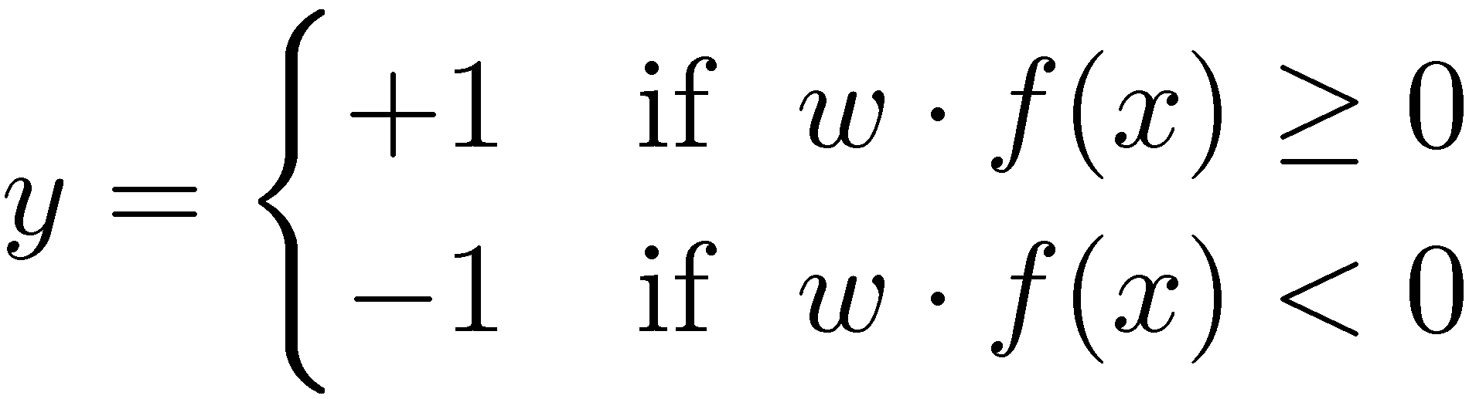

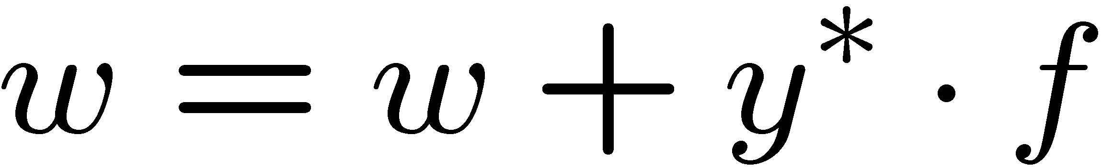
Learning: Binary Perceptron
Start with weights = 0
For each training instance:
Classify with current weights
If correct (i.e., y=y*), no change!
If wrong: adjust the weight vector by adding or subtracting the feature vector. Subtract if y* is -1.
Notes:
http://isl.ira.uka.de/neuralNetCourse/2004/VL_11_5/Perceptron.html

Slide 13
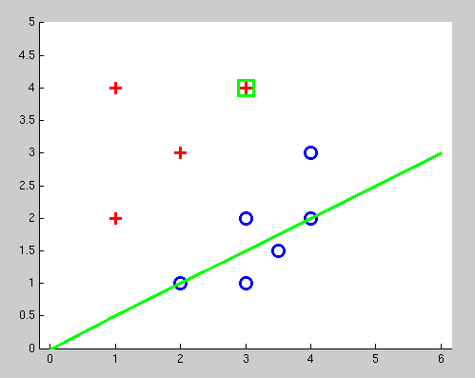
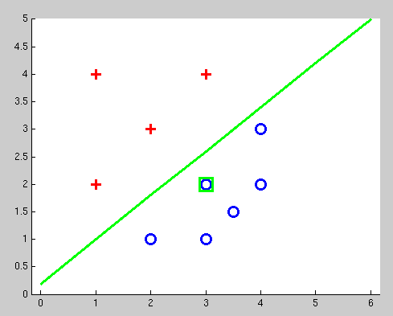
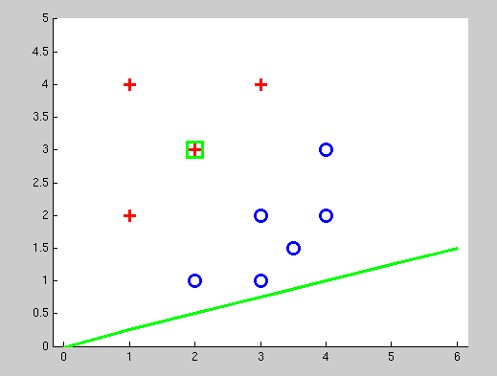
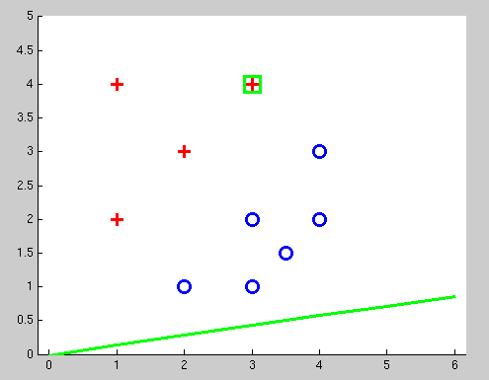
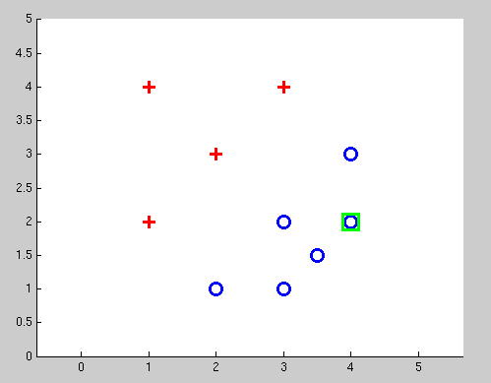
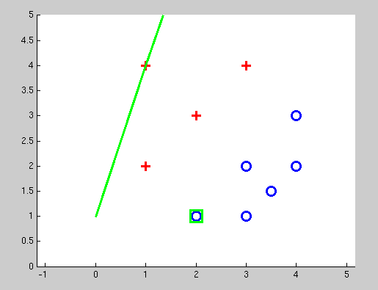
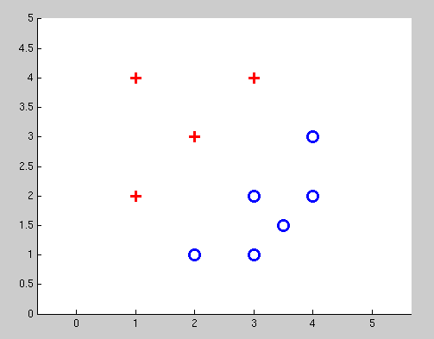
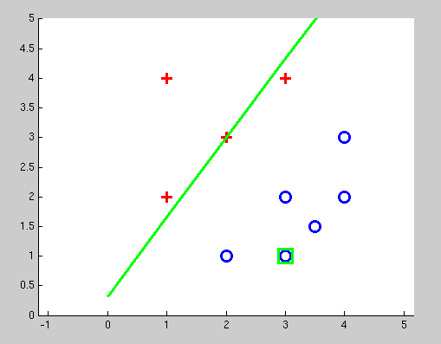
Examples: Perceptron
Separable Case

Slide 14

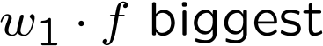
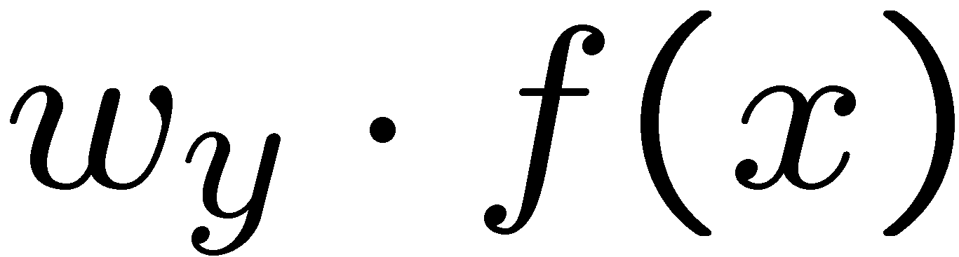



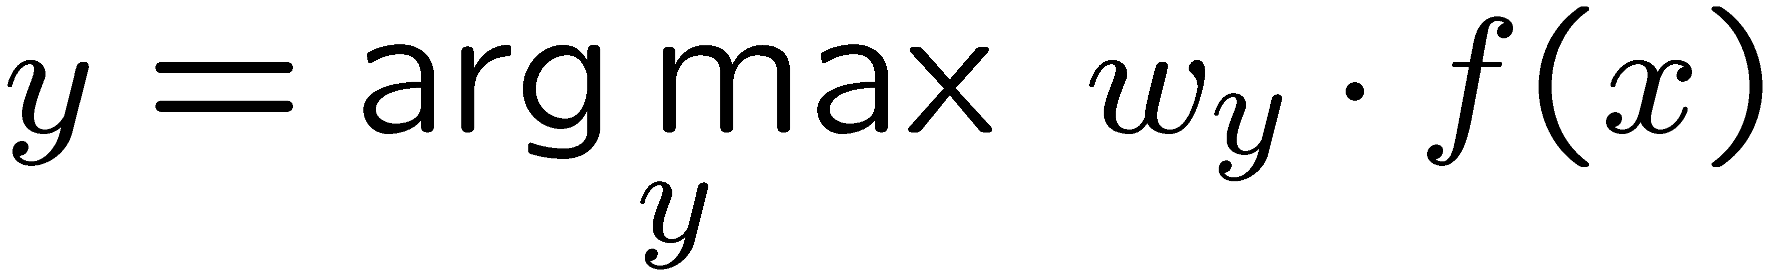
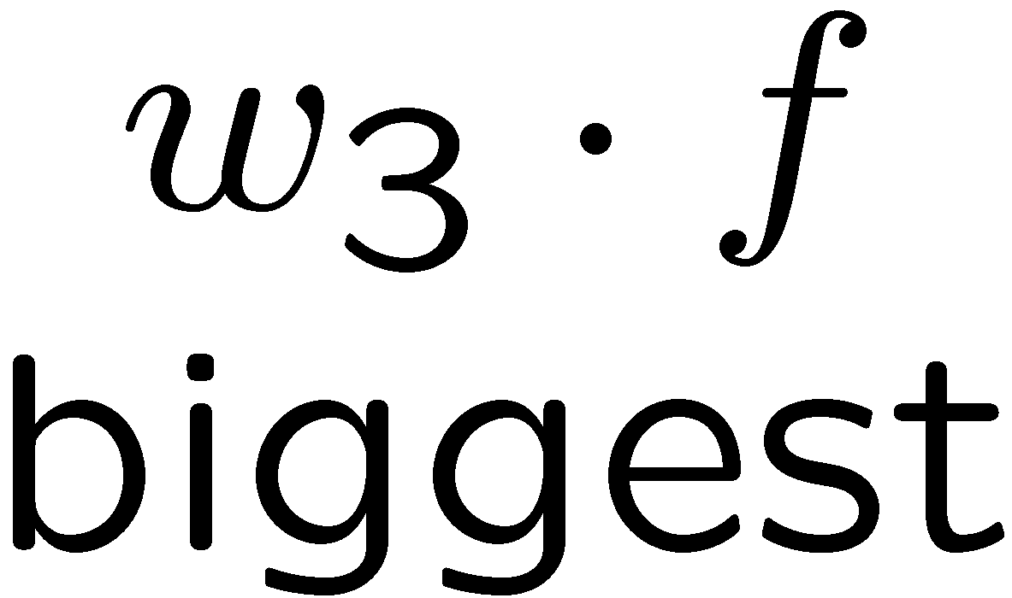
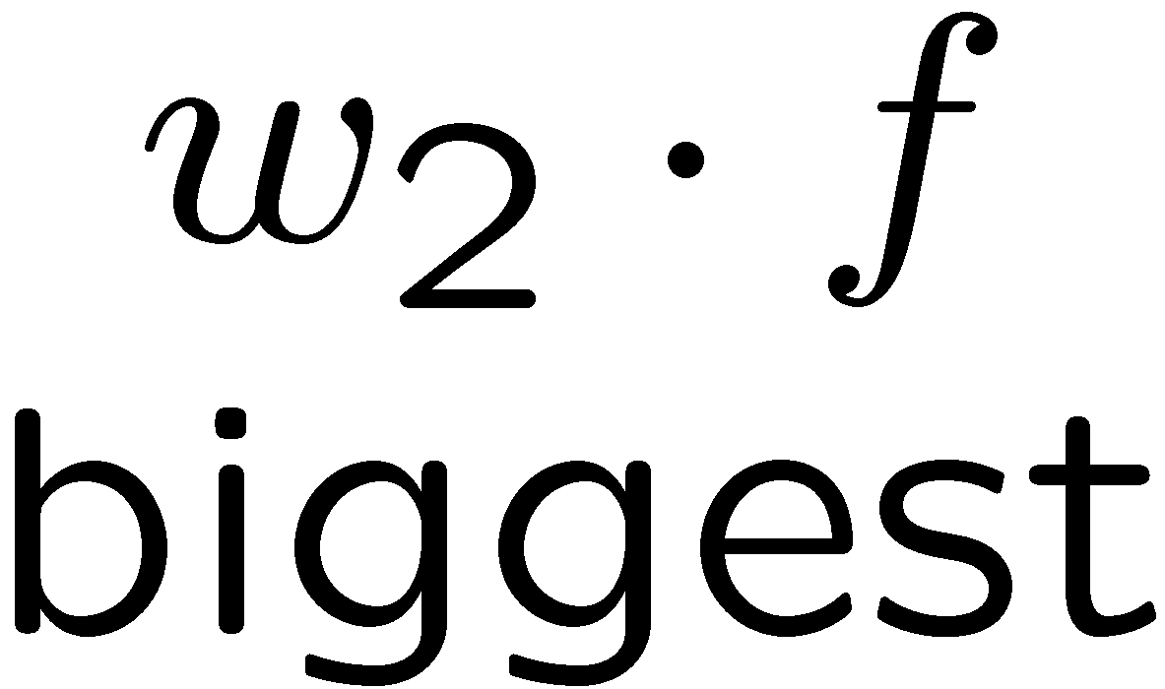

Multiclass Decision Rule
If we have multiple classes:
A weight vector for each class:
Score (activation) of a class y:
Prediction highest score wins
Binary = multiclass where the negative class has weight zero

Slide 15



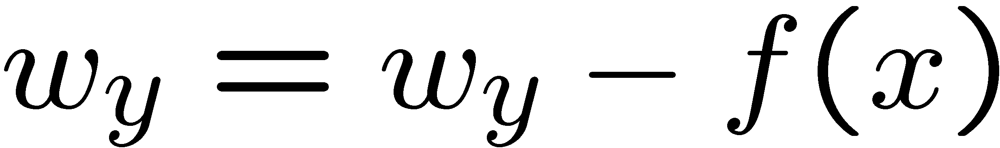
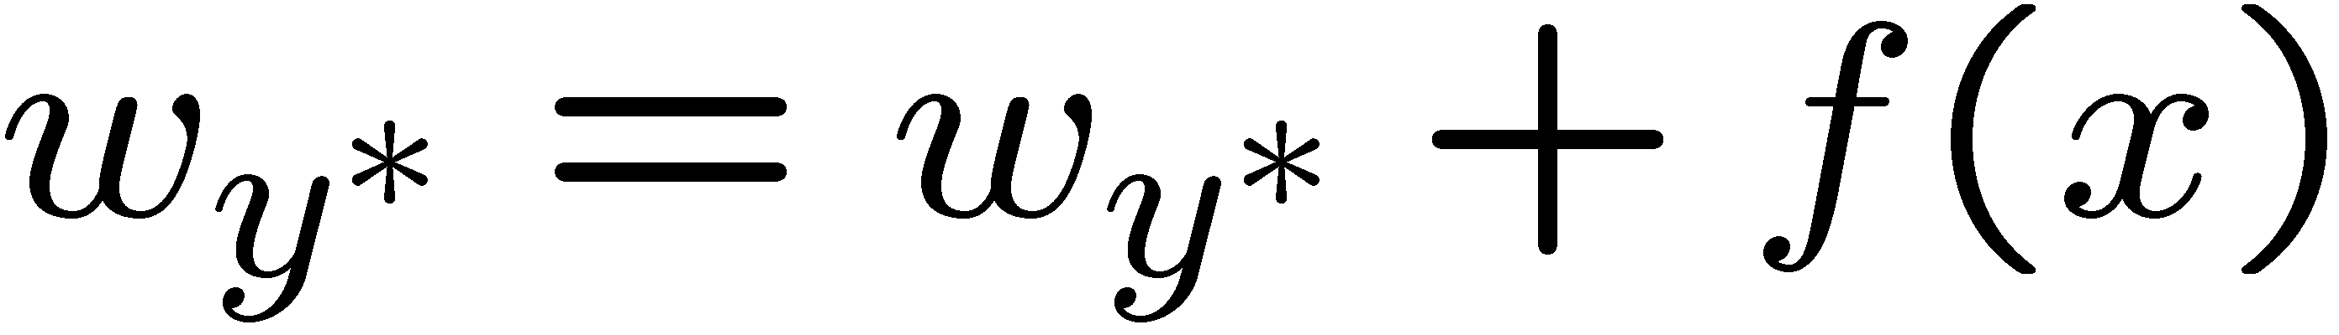
Learning: Multiclass Perceptron
Start with all weights = 0
Pick up training examples one by one
Predict with current weights
If correct, no change!
If wrong: lower score of wrong answer, raise score of right answer

Slide 16
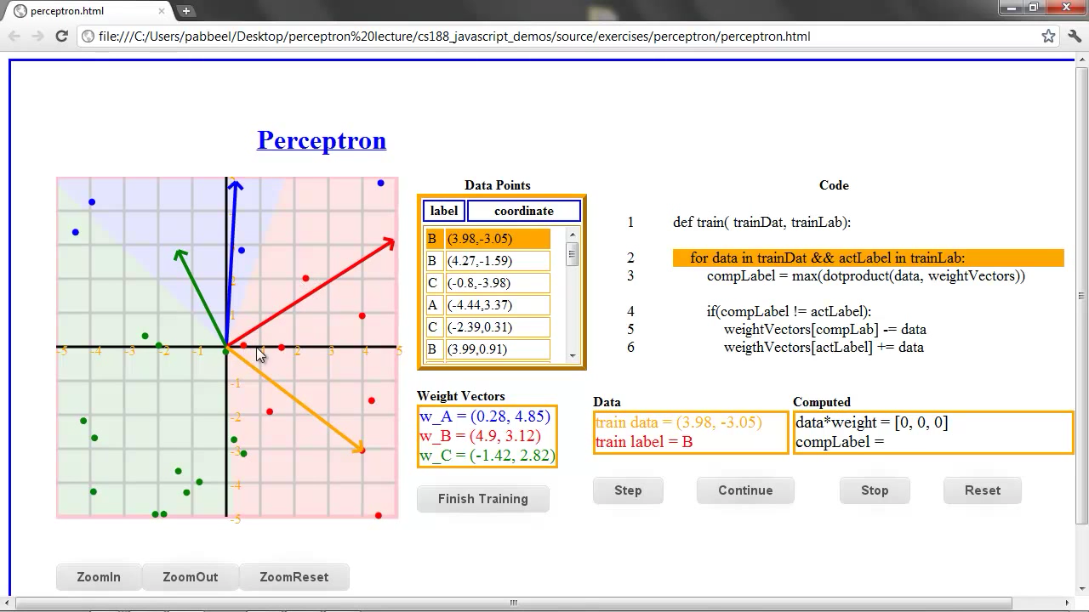

Slide 17



Example: Multiclass Perceptron
“win the vote”
“win the election”
“win the game”
BIAS : 1
win : 0
game : 0
vote : 0
the : 0
...
BIAS : 0
win : 0
game : 0
vote : 0
the : 0
...
BIAS : 0
win : 0
game : 0
vote : 0
the : 0
...

Slide 18
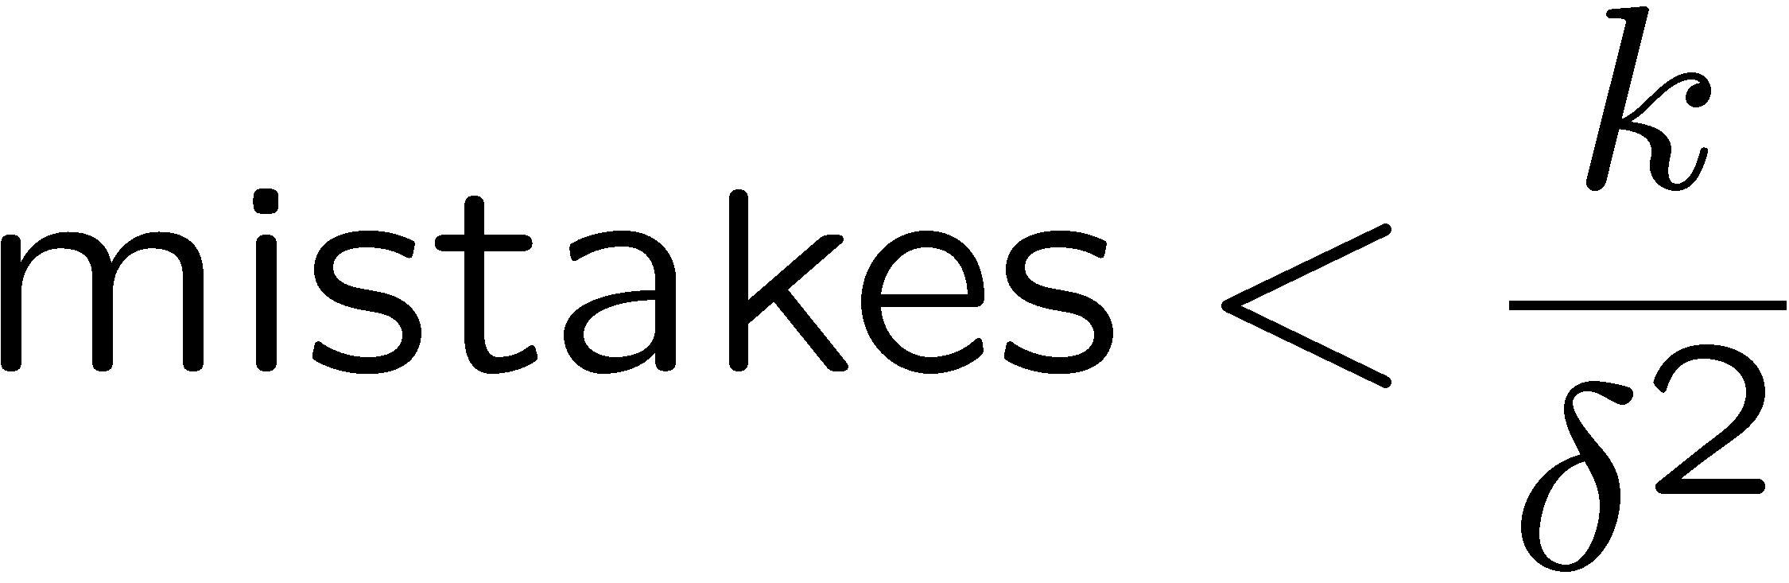
Properties of Perceptrons
Separable
Separability: true if some parameters get the training set perfectly correct
Convergence: if the training is separable, perceptron will eventually converge (binary case)
Mistake Bound: the maximum number of mistakes (binary case) related to the margin or degree of separability
Non-Separable

Slide 19
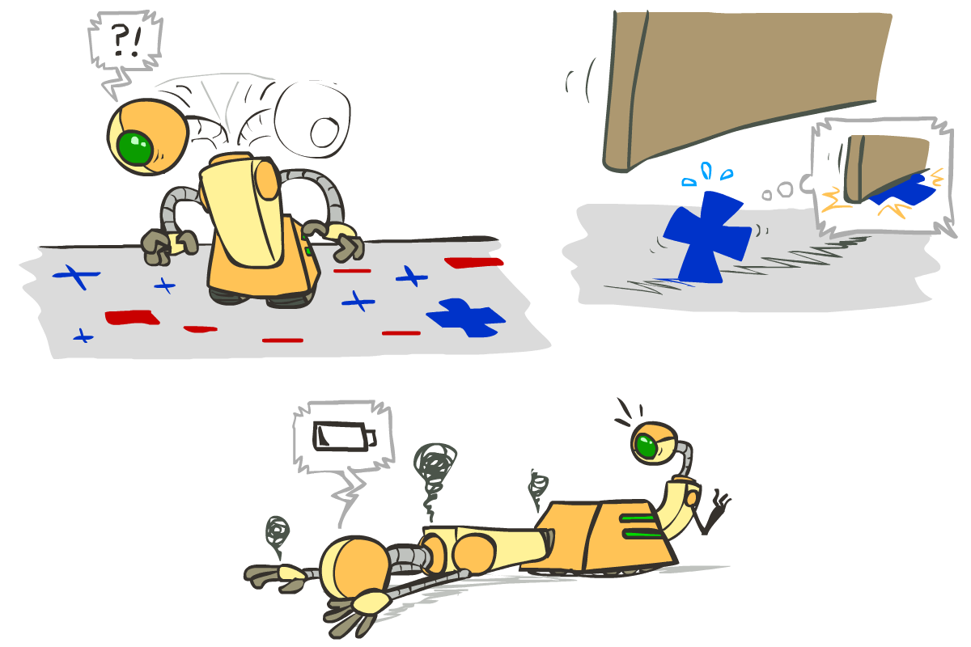





Problems with the Perceptron
Noise: if the data isn’t separable, weights might thrash
Averaging weight vectors over time can help (averaged perceptron)
Mediocre generalization: finds a “barely” separating solution
Overtraining: test / held-out accuracy usually rises, then falls
Overtraining is a kind of overfitting

Slide 20
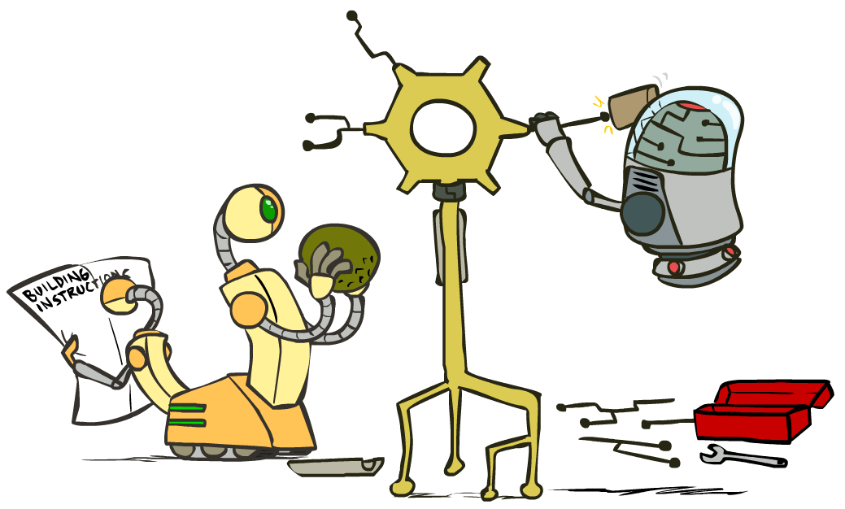
Improving the Perceptron

Slide 21
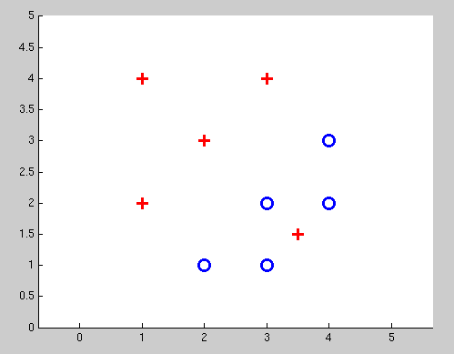
Non-Separable Case: Deterministic Decision
Even the best linear boundary makes at least one mistake

Slide 22
Non-Separable Case: Probabilistic Decision
0.9 | 0.1
0.7 | 0.3
0.5 | 0.5
0.3 | 0.7
0.1 | 0.9

Slide 23
How to get probabilistic decisions?
Perceptron scoring:
If very positive → want probability going to 1
If very negative → want probability going to 0
Sigmoid function

Slide 24
Best w?
Maximum likelihood estimation:
with:
= Logistic Regression

Slide 25
Separable Case: Deterministic Decision – Many Options

Slide 26
Separable Case: Probabilistic Decision – Clear Preference
0.7 | 0.3
0.5 | 0.5
0.7 | 0.3
0.3 | 0.7
0.5 | 0.5
0.3 | 0.7

Slide 27
Multiclass Logistic Regression
Recall Perceptron:
A weight vector for each class:
Score (activation) of a class y:
Prediction highest score wins
How to make the scores into probabilities?
original activations
softmax activations

Slide 28
Best w?
Maximum likelihood estimation:
with:
= Multi-Class Logistic Regression

Slide 29
Problem formulation
Optimization
i.e., how do we solve:

Slide 30
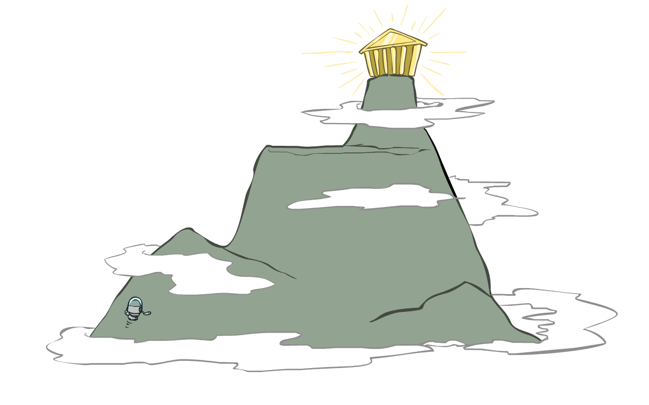
Hill Climbing
Recall from CSPs lecture: simple, general idea
Start wherever
Repeat: move to the best neighboring state
If no neighbors better than current, quit
What’s particularly tricky when hill-climbing for multiclass logistic regression?
Optimization over a continuous space
Infinitely many neighbors!
How to do this efficiently?

